Slide 1

USTITEM project – final version
(Upstream Satellites Technology Improvement Towards Enlarging Market, USTITEM)
Mauro Aliano
Martino Lo Cascio
FUET team

Slide 2
Contents
Market overview and Thales Alenia Spazio
USTITEM project and matrix hypotheses
Other assumptions
Prudential approach and measures
State and region aids
Additional results
  Sensitive analysis
  Impact of state contribution
Overview for next operational steps to develop

Slide 3
A taxonomy of the aerospace branches
Upstream segment: design, manufacture, assembly, launch, functioning, maintenance, monitoring and repair;
Downstream segment: data and knowledge derived from the space for Earth-related objectives (products and services that support them).
“…Upstream segment can be seen as the provision of space technology, whereas the downstream segment can be seen as the exploitation of space technology“
(2018) Growing the Space Economy: The Downstream Segment as a Driver
Market overview…

Slide 4
Upstream vs Downstream in a nutshell
At 2016 in the world (2018, Growing the Space Economy: The Downstream Segment as a Driver):
  Upstream 77 bln of USD
  Downstream 177 bln of USD (source:2018, Growing the Space Economy: The Downstream Segment as a Driver):
Following «The space alliance hand book» (2017), the branches EO and Meteo manufacturing are excepted almost double over the next 10 years.
Market overview…

Slide 5
Upstream vs downstream: push or pull
Innovation
Upstream
Downstream
Market
Down-stream: technology pull or Market pull?
Market overview…

Slide 6
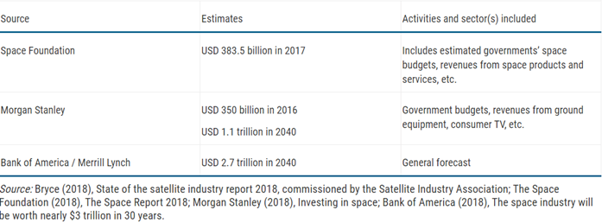
Bryce world overview
Market overview

Slide 7
The OECD cycles
Cycles | Dates | Description
Pre-space age “-1” | 1926-1942 | First rockets (from Goddard to the V2)
Pre-space age “0” | 1943-1957 | Military race for intercontinental ballistic missiles, first satellite on orbit (i.e. Sputnik)
Cycle 1 | 1958-1972 | Space race (from Sputnik to the end of the Apollo era), beginning of military applications (e.g. spy satellites), first humans in space, robotic space exploration
Cycle 2 | 1973-1986 | First space stations (Skylab, Salyut) and shuttles (US space shuttle, Buran), further development of military applications (GPS, Glonass), beginning of civilian and commercial applications (earth observation, telecommunications), emergence of new actors (Europe, Japan, China)
Cycle 3 | 1987-2002 | Second generation of space stations (Mir, ISS), stronger role of space applications in militaries, further development of civilian and commercial applications (Landsat, Spot Image, satellite television), with more actors entering markets, and many space technology transfers at the end of cold war
Cycle 4 | 2003-2018 | Ubiquitous use of space applications in various fields thanks to digitalisation (strong rise of downstream activities), new generation of space systems (small satellites) prompted by integration of breakthroughs in micro-electronics, computers, and material sciences, globalisation of space activities (large and very small national space programmes coexist, development of global value chains)
Source: OECD The Space Economy in Figures How Space Contributes to the Global Economy
Market overview…

Slide 8
The OECD cycles (2)
Cycle 5 | 2018-2033 | Growing uses of satellite infrastructure outputs (signals, data) in mass-market products and possibly for global monitoring of treaties (land, ocean, climate), third generation of space stations, extensive mapping of solar system and beyond thanks to new telescopes and robotic missions, new space activities coming of age (e.g. new human-rated space launchers, in-orbit servicing)
Source: OECD The Space Economy in Figures How Space Contributes to the Global Economy
Market overview…

Slide 9
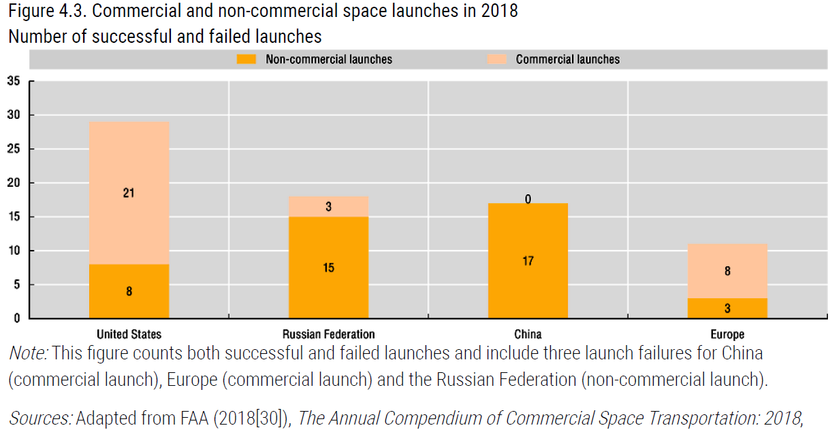
Space launches in 2018
Source: OECD The Space Economy in Figures How Space Contributes to the Global Economy
Market overview…

Slide 10
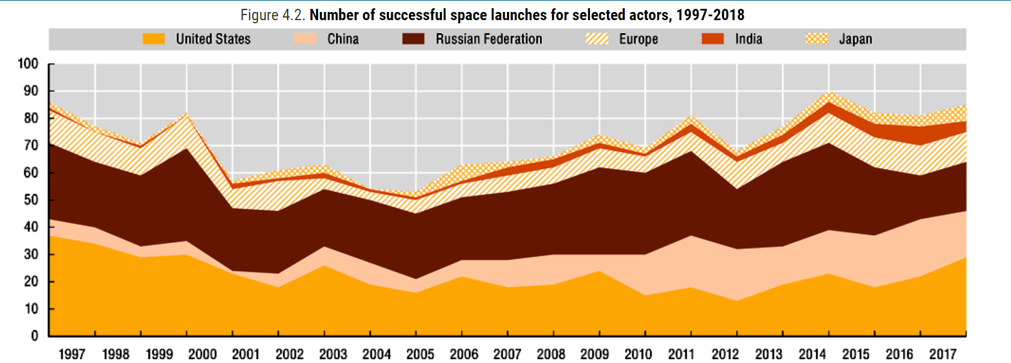
Number of successful launches
Source: OECD The Space Economy in Figures How Space Contributes to the Global Economy
Market overview…

Slide 11
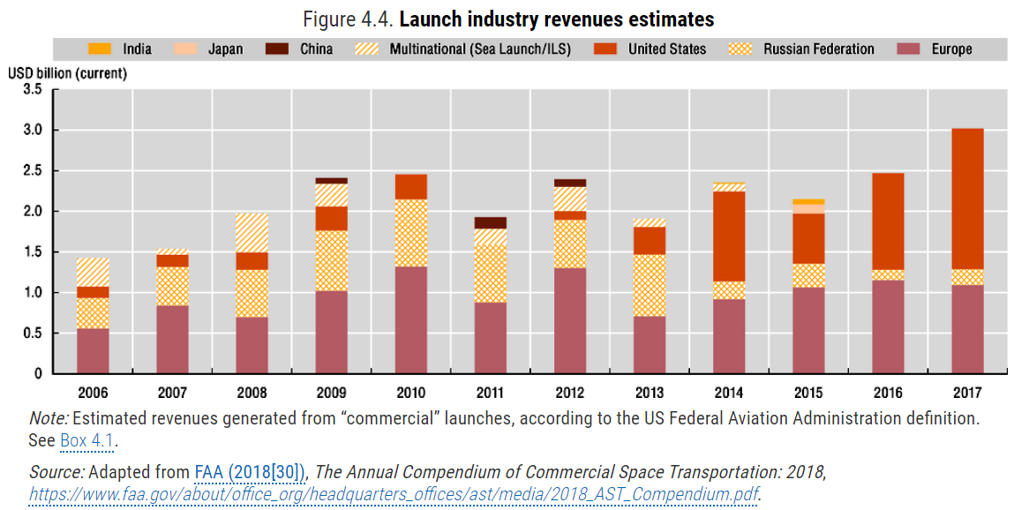
Launch industry: Europe is growing
Europe is
growing
Source: OECD The Space Economy in Figures How Space Contributes to the Global Economy
Market overview…

Slide 12
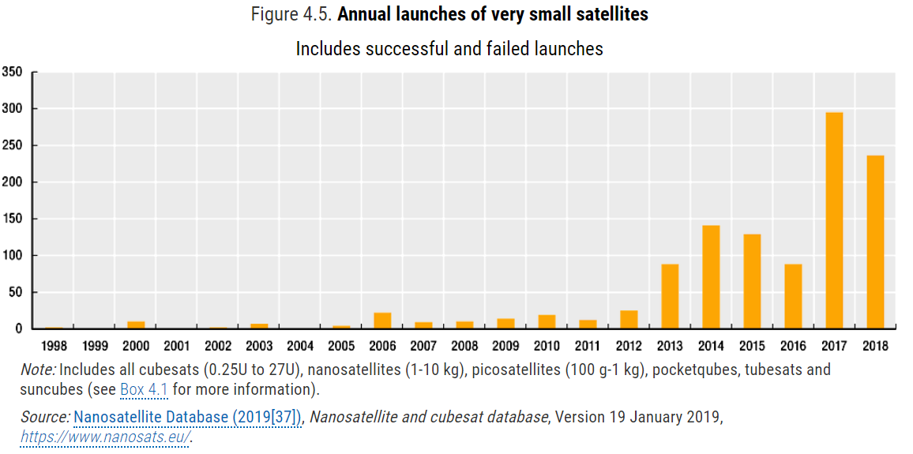
Very small satellites launches
Very small satellites launches exponential growth couple with large cycle movement
Source: OECD The Space Economy in Figures How Space Contributes to the Global Economy
Market overview

Slide 13
The evolution of technology
Cost of launchesFrom 18.000 USD per KG in 1970 to 2.700 per KG in 2018
2 billions of private investment in 2018
23 unicorn in 2018
Market overview

Slide 14
The evolution of technology
Cost of launches: from 18.000 USD per KG in 1970 to 2.700 per KG in 2018;
2 billions of private investment in 2018
23 unicorn in 2018.
Market overview

Slide 15
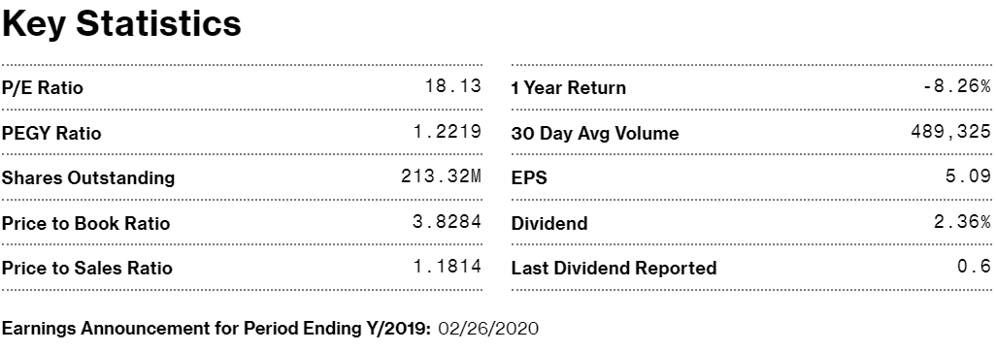
Thales group key figures
Order book: 32.3 mln of euro
Order in take: 16 bln of euro
Sales: 15 bln of euro
EBITDA: 1, 68 bln of euro
Market overview

Slide 16
Thales Alenia Italia spa
Total revenues (2018): 707.31 mln of euro
Profit (2018): 32 mln of euro (28 in 2016 and 24 in 2017)
Magnitude order by which the USTITEM project must be evaluated: from 9% to 25% of 2016 – 2018 period profit.
Market overview

Slide 17
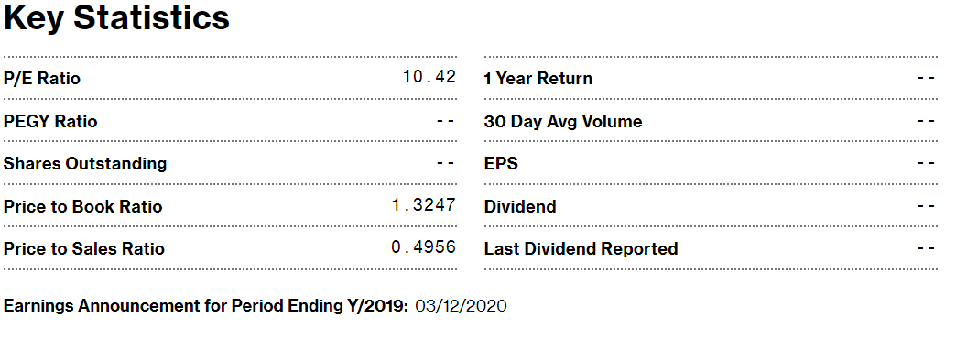
Leonardo key figures
Order in take: 9.6 bn of euro
Revenues: 12.4 bn of euro
EBITDA: 510 mln of euro

Slide 18
Summing up
Future satellite market expansion doubles world economy and trade;
High variability in satellite dimension ;
VSS (Very Small Satellites) exponential past trend coupled with large cycle fluctuations;
Strategical need: flexibility in satellites dimension supply to cope market growth (for the next 10 year);
To do this, we present two alternative assumptions:
  Building an automated facility for Satellite Assembly, Integration and Test (AIT) activities;
  Rearranging the current production process in order to automatize the current facility.
Market overview…

Slide 19
USTITEM project and
Investment hypotheses
10 mln: only machinery and system investments, in the current production site (first wave);
55 mln: new facility, changing production site in a wider area (second wave):
  Machinery and system 27 mln
  Other 28 mln
TVT CHAMBER
THERMAL CHAMBER
VIBRATION TEST SYSTEM
MEASUREMENT OF MASS AND MOMENT OF INERTIA SYSTEM
COMPACT ANTENNA TEST RANGE (CATR)
SOLAR ARRAY DEPLOYMENT SYSTEM (SADR)
Land, building and related costs
USTITEM project…

Slide 20
Production hypotheses
The lack of above investments cause:
  overloads production (repercussion on raw materials costs);
  manufacturing processes are inadequate ( repercussion on CCPII current costs).
We can make 4 hypotheses to overcome troubles:
  In HP 1.1 and HP 1.2, CCPII current costs fall only of 10% (in relation 10 mln investments in machinery and system) ; in HP 2.1 and HP 2.2 (27mln in machinery and system investments) CCPII current costs fall of 20%;
  In HP 1.2 raw materials costs fall only of 3-4% (in proportion to machinery and system investments) instead of HP 2.2 where raw materials cost fall of 10% .
USTITEM project…

Slide 21
Hypotheses matrix
Scenarios by FUET team and Competence Center
 | No falls of current raw materials | Raw materials cost falls of 3-4% | Raw materials cost falls of 10%
CCPII current cost falls (10%) | HP 1.1 | HP 1.2 | -
CCPII current cost falls (20%) | HP 2.1 | - | HP 2.2
Only machinery and system investments (10 mln) | New Facility (55 mln)
HP 1.1, HP 1.2 | HP 2.1, HP 2.2
USTITEM project…

Slide 22
Other assumptions
Financial charge (2.20% per year)*;
Duration loans 5 (HP 1.1 and 1.2) and 10 years (HP 2.1 and 2.2) ;
Fixed installment repayment plan (c.d. ammortamento francese);
Obsolescence cost equals 400 k for the first year**(costs not incurred for HP 2.1 and HP 2.2) with an estimated annual growth of 5%.
*BTP 10 year yield (1.40% - Italy Generic Govt 10Y Yield)+ spread (80 basis points)
** provided by Competence Center
Other assumptions

Slide 23
Prudential approach
Cost reduction= change in profit (prudential approach)
Measures:
  Payback period;
  ROI;
  IRR.
The impact of region and state aids:
  Innovation process (outright grants);
  Employment (employment incentives);
  Tax benefits;
  Impact of non-repayable contribution on:
    ROI;
    Payback period;
    IRR.
How costs reduction can repays the additional investment:
Prudential approach…

Slide 24
Savings and payback period HP 1.2
Cumulative savings (mln di euro)
Cumulative savings (mln di euro)
ROI (annualized) = 5-6%
Prudential approach…

Slide 25
Incremental cumulative Cash Flow HP 1.2
Mln of euro
IRR = 3%
*first installment of loan 30 Jun 2020. First saving : Q3 2021.
Prudential approach…

Slide 26
Savings and payback period HP 2.2
Cumulative savings
Cumulative savings
ROI (annualized) = 7%*
*% of residual value of new facility after 10 years : 80%
Prudential approach…

Slide 27
Impact on Income Statement
Hypotheses:
Building depreciation: 5% (20 years)
Plant depreciation: 12% ( 8-9 years)
Positive cost: impact of financial charge
Negative cost: saving

Slide 28
HP 2.2 with 60 mln of investment
Key figure
ROI= 6.2%
Payback: 7-8 years
IRR: 5.4%
Income statement

Slide 29
HP 2.2 with 55 mln of investment (9.5% of interest rate)
Key figure
ROI= 4.29 %
Payback: over 10 years
IRR: 5.26 %
Key figure
ROI= 6.78 %
Payback: 8-9 years
IRR: 7.16 %
CCPPI saving 25%
Raw material 15%

Slide 30
HP 2.2 with 60 mln of investment (9.5% of interest rate)
Key figure
ROI= 3.78%
Payback: over 10 years
IRR: 5.2 %
Key figure
ROI= 6.17%
Payback: 8-9 years
IRR: 7 %
CCPPI saving 25%
Raw material 15%

Slide 31
Incremental Cumulative Cash Flow HP 2.2
Mln of euro
IRR = 7,09 %
*first installment of loan 30 Jun 2020. First saving : Q3 2021.
Prudential approach…

Slide 32
Payback period by hypotheses
 | HP 1.1 | HP 1.2 | HP 2.1 | HP 2.2
Payback | 5-6 years | 3-4 years | Over 10 years | 7 years
Investment period | 5 year loan | 5 year loan | 10 year loan | 10 year loan
Prudential approach…

Slide 33
HP 1.2 vs HP 2.2
ROI captures economic aspects, while IRR captures financial aspects;
For HP 2.2 ROI and IRR are definitely on a similar level;
For HP 1.2 ROI has a high value than IRR (due to the incidence delay of loan payment and savings in production);
In case of “hard aid” (see later) , IRR is advisable;
The investment return in the range of 3-7% makes economic and financial sense.
Payback periods are less than investment duration.
Prudential approach…

Slide 34
State and regional aid
Employment regional support for increase in employment:
  Programma Operativo Regionale (POR) FSE 2014-2020 - Bonus assunzionale per le imprese - De Minimis (8 k per worker recruited, subject to availability of funds).
State and regional aid

Slide 35
Soft state aid
Industry 4.0:
  Iper ammortamento: machinery investment up to 20 mln (tax benefit);
  ….;
State and regional aid

Slide 36
Hard state and regional financial aid
Legge 181 del 1989;
Contratto di sviluppo:
  On demand;
  for investments starting from 20 mln;
  capital contributions (grant component);
  interest subsidy;
  Etc.
Accordo di Sviluppo:
  On demand;
  fast lane;
  With co-partecipation of region;
  for investments starting from 50 mln;
  capital contributions (grant component);
  Etc.
  with co-partecipation of Lazio region
State and regional aid

Slide 37
R and D activities
Accordi di Innovazione:
  Research and Development projects
  Agreement between region and MISE
  Negotiated procedure
  From 5 to 40 mln of euro.
Competence center, Industry 4.0:
  Innovation hub;
  CIM 4.0 (with Alenia Thales), manufacturing industrial pole.

Slide 38
Hard aid – key figures
Overview for next operational steps to develop. Key figures to achieve financial support:
Increase in employment;
Increase in productivity;
Follow on of R&D capability;
Co-partecipation with Lazio region.
State and regional aid

Slide 39
Additional results
Conventional sensitive analyses and medium-long patterns;
Impact of non-repayble contribution;
Additional results

Slide 40
Sensitive analyses
HP 2.2
Impulse-response analysis
x
 | raw material cost | CCPPI cost | residual value of facility
ROI | 0.282 | 0.158 | 0.047
Payback | -25.915 | -10.705 | 0.739
IRR | 0.301 | 0.154 | -
y
Mean of percentual changes of «y» due to percentual changes «x»
(ceteris paribus, detailed year figures in the report)
Additional results

Slide 41
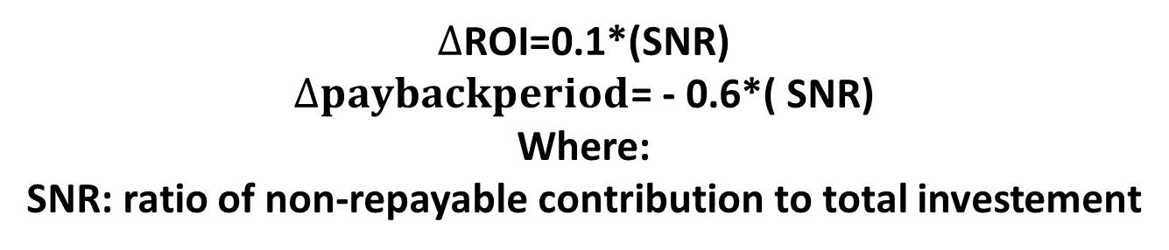
Hard aid: the impact on performance
The impact on performance of hard state aid in case of “non-repayable contributions”;
  Impact on ROI;
  Impact on payback period;
For a later discussion!!!
Ceteris paribus
$∆$ROI=0.1*(SNR)
$∆paybackperiod$= - 0.6*( SNR)
Where:
SNR: ratio of non-repayable contribution to total investement
Additional results

Slide 42
Overview for next operational steps to develop
Low probability shocks, like international bad news or something like to a sort of “italexit” scenario;
How to get contribution, interest subsidy, tax benefits, etc. (fill Thales Alenia request for state and region aids)
Next steps

